Slide 1
TIMBER-V: Tag-Isolated Memory Bringing Fine-grained Enclaves to RISC-V
Samuel Weiser Mario Werner
Ferdinand Brassery Maja Malenko
Stefan Mangard Ahmad-Reza Sadeghiy

Slide 2
Tagged Memory

Slide 3
Design Goals
G1 Security
(i) strong memory isolation (ii) secure entry points
(iii) secure communication (iv) attestation and sealing
G2 Flexibility
(i) fine-grained (ii) dynamically reconfigurable isolation boundaries
G3 Compatibility
Support existing os and apps without modification
G4 Low Overhead
(i) cost of tagged memory (ii) performance overhead of switching security domains
G5 Real-time

Slide 4
Tag Isolation Policy
Tagged Memory
Tag-aware Instruction
Hardware
Memory Protected Unit
TIMBER-V
Software
Compatibility
Code Transformation

Slide 5
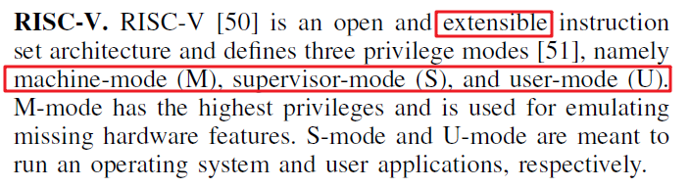
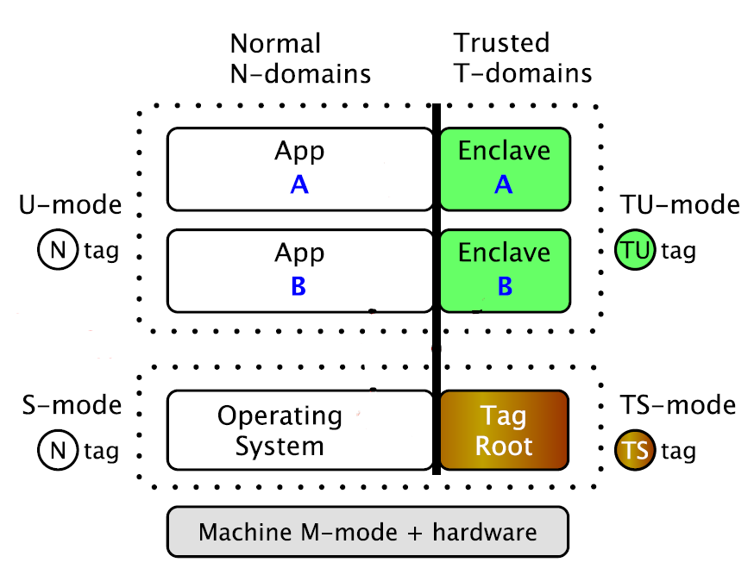
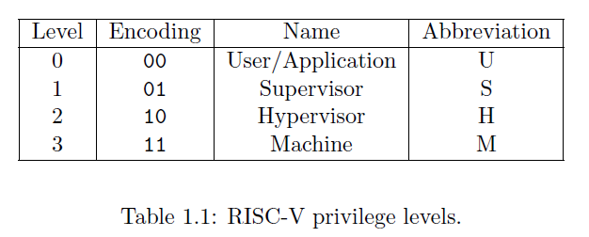
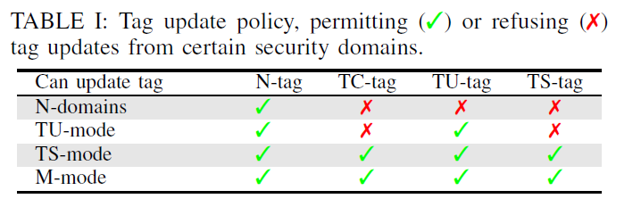
Tag Isolation Policy
At any time, a RISC-V hardware thread (hart) is running at some privilege level encoded as a mode in one or more CSRs (control and status registers).

